Slide 1
Rekayasa Piranti Lunak
#8
DFD and Flowcharts
Eunike Endariahna S, S.Kom., M.T.I
Fakultas Teknik & Informatika
Prodi Informatika, Ganjil 2020/2021
Universitas Multimedia Nusantara

Slide 2
Data Flow Diagrams
To conceptualize how data move through the organization, the processes or transformation that the data undergo, and what the outputs are.
Using only four symbols.

Slide 3
Symbols
1
Student
Create Student Record
Entity
Process
Student Information
D1
Student Master
Data Flow
Data Store

Slide 4
Symbols: Entity
External entity that can send or receive data from the software
Outside the boundaries of the
software
Same entity may be used more than once to avoid crossing data flow lines
Student
Entity
Example: Student, IT Department, API, Cash Register

Slide 5
Symbols: Processes
For high-level process, name the process as the whole system (e.g. Inventory Control System)
For major subsystem, use names such as Inventory Reporting
Subsystem or Internet Customer Fulfillment Subsystem.
For detailed processes, use a verb-
adjective-noun combination
Use number to assign levels
1
Create Student Record
Process

Slide 6
Symbols: Data Flow
Shows the movements of data from one point to another
Should be described with noun
Data Flow

Slide 7
Symbols: Data Store
Shows a depository for data that allows examination, addition, and retrieval of data
May represent manual store, such as file cabinet, or database
Temporary data stores are not included
D1
Student Master
Data Store

Slide 8
Basic Rules
Must have at least one process and no freestanding objects or objects connected to themselves
A process must have at least one input and one output data flow
A data store should be connected to at least one
process
External entities should not be connected to each other. Although they communicate independently, that communication is not part of the system we design using DFDs

Slide 9
Levels
Context Diagram : Level 0
Contains only one process, the entire system
Basic inputs, the general system, and outputs
The context diagram must fit in one page.
The process name in the context diagram should be the name of the information system.
Diagram Level 1
Inputs and outputs to entities remain constant
However the processes are exploded up to 9 processes
Data stores are here
Diagram Level 2
Detailed diagram for each process from the previous diagram
and so on…

Slide 10
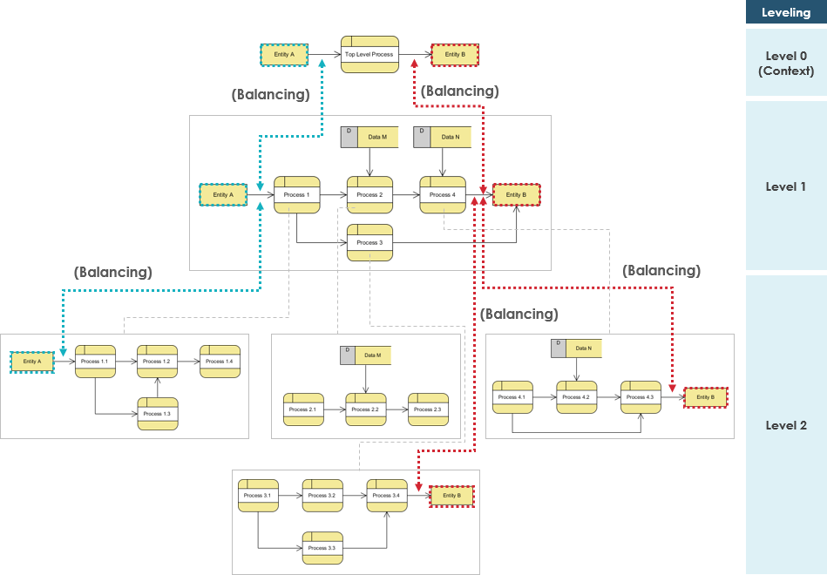

Slide 11
Balancing DFD
When performing top-down decomposition to a DFD to lower level DFDs, the inputs and outputs must be conserved between levels of DFDs. For example, level n & n+1 must have the same inputs and outputs
Unique Name for Levels
Use unique names within each set of symbols.
No Cross Line in DFD
One way to achieve this is to restrict the number of processes in a data-flow diagram.
Numbering Convention: Use a unique reference number for each process symbol.
Other process numbers are in the hierarchy of:
(1, 2, 3,...);
(1.1, 1.2, 1.3, ..., 2.1, 2.2, 2.3,...);
(1.1.1, 1.1.2, 1.1.3,...).

Slide 12
Common Mistakes
Forgetting to include a data flow or pointing an arrow in the wrong direction
Connecting data stores and external entities directly to each other
Incorrectly labeling processes or data flow
Including more than nine processes on a data flow diagram
Omitting data flows
Creating unbalanced decomposition

Slide 13
Logical & Physical DFD
Features | Logical | Physical
What it depicts | How the business operates | How the system will be implemented
What the processes represent | Business activities | Programs, modules, manual procedures
What data stores represent | Collection of data regardless of how | Physical files and DB, manual files
Type of data store | Permanent data collection | Master files, transition files (temporary)
System controls | Business controls | Show controls for validating input data, for obtaining a record, for ensuring successful completion of a process, and for system security

Slide 14
Steps
Current Logical DFD
New/Proposed Logical DFD
New Physical DFD

Slide 15
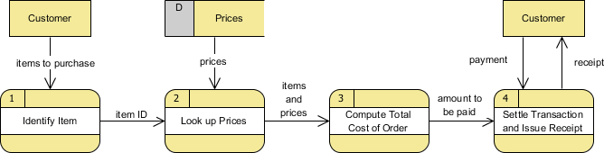
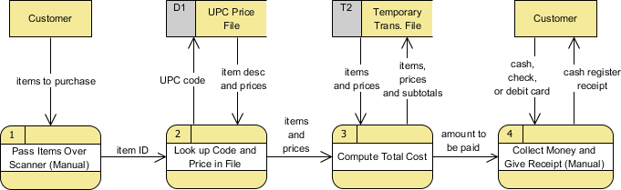
Logical DFD
Physical DFD

Slide 16
Class Assignment (30-60 minutes)
Create a software application using DFD (context lv 0, lv. 1, and lv. 2) and flowchart of at least one process in the DFD which needs to be further described.
Case Study:
A stock and transaction management application in a
small shop or minimarket (imagine a traditional convenient store). When drawing the data flow
diagrams, there should be at least 2 external entities which are the Buyer and the ShopOwner.

Slide 17
Flowcharts
Terminal
Indicates the starting or stopping point
Every flowcharts should begin and end with this symbol
I/O
e.g. reading input or writing/displaying output
Process
Represents any single process (e.g. assigning a value, performing calculation)
Source: Lesley Anne Robertson, Simple Program Design: A Step-by-Step Approach 5th edition, Course Technology, a part of Cengage Learning (2007).

Slide 18
Flowcharts
Predefined Process
Represents any module in an algorithm
Deci sion
Represents a decision in the logic involving the comparison of two values
Connects various symbols in a flowchart, and contain an arrowhead only when the flow of control is not from top to bottom or left to right.
Source: Lesley Anne Robertson, Simple Program Design: A Step-by-Step Approach 5th edition, Course Technology, a part of Cengage Learning (2007).

Slide 19
Flowcharts: Example
Define a solution algorithm that will:
prompt a terminal operator for three characters,
accept those characters as input,
sort them into ascending sequence, and
output them to the screen.
The algorithm is to continue to read characters until XXX is entered.

Slide 20
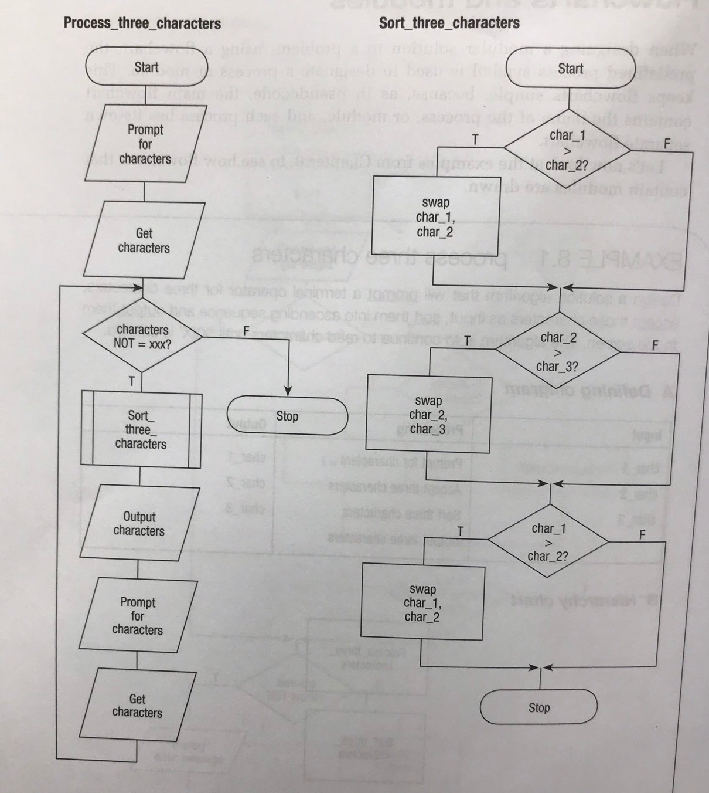
Flowcharts: Example

